Slide 1
Election Sentiment Analysis Through Natural Language Processing of Political Discourse
Group 35
Submission 4
Kadir Hasan (20101332)
Kaji Sajjad Hossain (20101321)
MD Zubairul Islam (20101322)
Noshin Tabassum (20101347)
Instructed by: Annajiat Alim Rasel
RA and ST: Sabbir & Mehnaz

Slide 2
OUTLINE
ABSTRACT
INTRODUCTION
RELATED WORKS
OVERVIEW OF DATASET
METHODOLOGY
CONCLUSION

Slide 3
ABSTRACT
Our project uses Natural Language Processing (NLP) to figure out how people feel about politics, especially during the very important US election. We clean up the data first, use visualizations for mapping, and use three natural language processing models (Textblob, BERT, and VADER) to look at the mood of Twitter data. This method helps people guess how elections will turn out by finding out how people feel about candidates and topics.

Slide 4
INTRODUCTION
The research uses advanced natural language processing (NLP) to analyse political rhetoric during elections with the goal of predicting the election winner.
Sentiment analysis is important for assessing public opinion since social media platforms—especially Twitter—are active hotspots for discourse linked to the upcoming election.
Election-related discussions on social media offer a valuable dataset reflecting diverse viewpoints and sentiments.
NLP-driven sentiment analysis provides a means to extract, analyze, and interpret sentiments from this extensive political discourse.
Our objective is to analyze the sentiment of people throughout the election by using various Natural Language Processing techniques.

Slide 5
RELATED WORKS
This paper employs natural language processing, including Latent Dirichlet Allocation and K-means clustering, to analyze social media behavior during the 2022 Philippines Presidential Election, revealing key narratives and achieving 73% accuracy in sentiment analysis with Support Vector Machine.
Solitana et al. [2] did analysis of Twitter posts for 2016 Philippines Presidential Election where word bubbles were generated to identify hate and non hate speeches with K-means clustering. Result shows that, 53% of non hate and 47% of hate tweets has been scraped which indicates non hate tweets dominates towards the election candidates.
This study [3] contributes to the dynamic domain of computational linguistics and political discourse analysis, in which prior research has utilized text analysis techniques such as TF-IDF, PCA, and LDA to identify recurring patterns and trends in political discourse. Previous inquiries have focused on analyzing the communication strategies employed by candidates, recognizing significant themes, and distinguishing linguistic patterns that distinguish political speakers.
The research[4] shows that twitter sentiment analysis data with the VADER model can predict the result of the United State’s president election. The result obtained from this sentiment analysis are not entirely similar to the actual result, but the overall result can represent Joe Biden’s victory over Donald Trump.

Slide 6
OVERVIEW OF DATASET
Data Origin: Derived from Twitter through APIs like "status_lookup" and "snsscrape" using election-related keywords.
Temporal Aspect: Spanning October to November 2020, capturing the evolving discourse around the election.
Contents: Approximately 958,580 tweets were fetched and analyzed, specifically mentioning "Donald Trump" and "Joe Biden."
Features: Main attributes included "tweet" (full tweet text), "likes," "source" (utility used for posting), "user_location," "city," and "country."
Objective: The dataset aimed to explore the correlation between Twitter sentiment and the eventual election results.
Analysis Focus: Considerations included whether tweets could influence or predict election outcomes, including state-wise analysis.
Data Processing: Features underwent preprocessing, including data cleaning, and irrelevant columns like "tweet_id," "collected_at," and "user_description" were removed.
Data Integration: Separate datasets for Trump and Biden were merged for comprehensive analysis.
Visualization: The combined dataset was visually analyzed to understand tweet counts under different scenarios for both Trump and Biden.

Slide 7
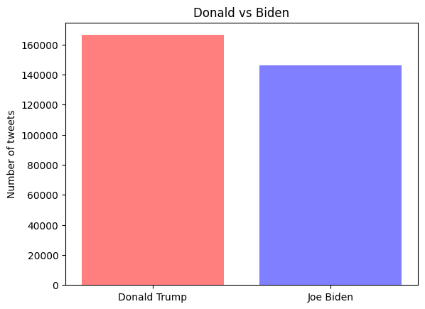

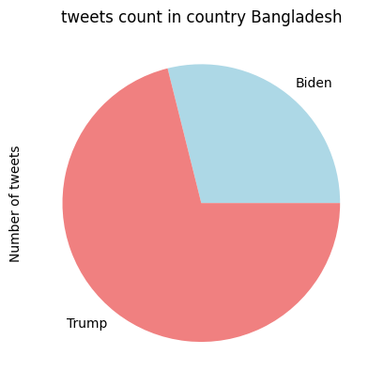
DATASET VISUALIZATION
Fig: No. of Tweets Between Candidates Fig: No. of Likes Between Candidates Fig:Tweets count in Bangladesh

Slide 8
METHODOLOGY
Data collection from kaggle.
Analysis of data
Pre-processing of data (merging,cleaning,visualization)
Application of NLP models for sentiment analysis
Determination of polarity score and subjectivity measurement.
Comparison of positivity, negativity and neutrality labels
Result visualization

Slide 9
CONCLUSION
Utilized various features within the dataset for analysis purposes. Applied visualization methods to understand and visualize tweet counts, sentiments, and other key attributes related to both candidates.
Explored correlations between sentiment trends observed on Twitter and potential implications for the election outcomes, aiming to understand if sentiments influenced or reflected the electoral behavior.
This research work emphasizes the need for continuous exploration, refining methodologies, and employing advanced techniques to gain deeper insights into the role of social media sentiments in elections.

Slide 10
THANK YOU

